Slide 2
Data Binding for Xamarin Forms In-Depth
Alejandro Ruiz
Microsoft MVP
@alejandroruizva
alejandro@alejandroruizvarela.com

Slide 3
Data Binding

Slide 4
Data Binding
Data binding is the technique of linking properties of two objects so that changes in one property are automatically reflected in the other property. Data binding is an integral part of the Model-View-ViewModel (MVVM) application architecture.

Slide 5
Basic Bindings

Slide 6
Basic Bindings
A Xamarin.Forms data binding links a pair of properties between two objects, at least one of which is usually a user-interface object. These two objects are called the target and the source:
The target is the object (and property) on which the data binding is set.
The source is the object (and property) referenced by the data binding.

Slide 7
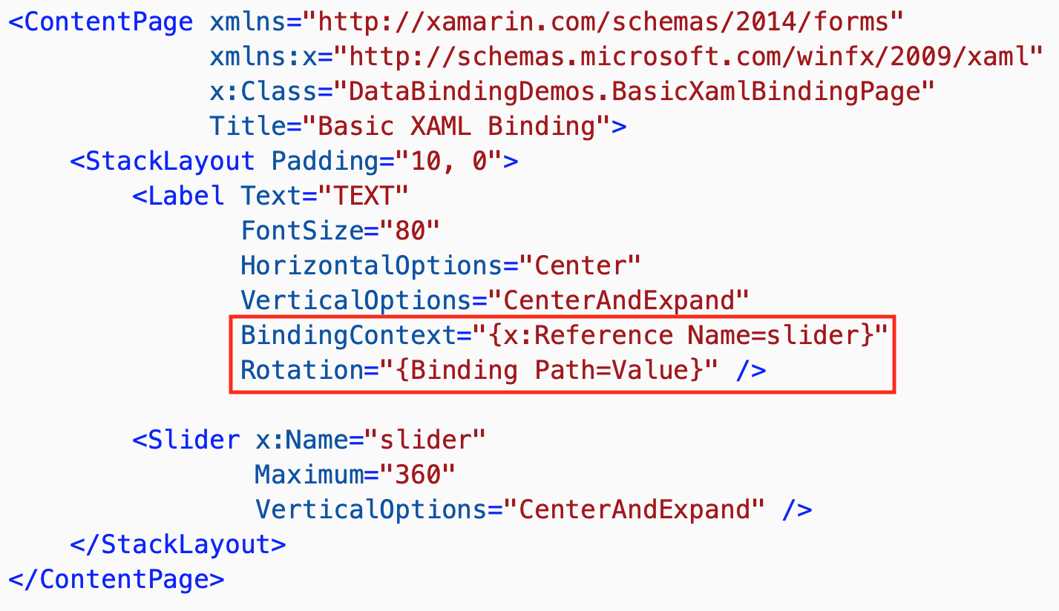

Slide 8
Binding Mode

Slide 9
Binding Mode
Allow to set the behavior of each data binding, the available options in Xamarin.Forms are:
Default
TwoWay – data goes both ways between source and target
OneWay – data goes from source to target
OneWayToSource – data goes from target to source
OneTime – data goes from source to target, but only when the BindingContext changes (>=Xamarin.Forms 3.0)
**Each property has his own default binding mode**

Slide 10
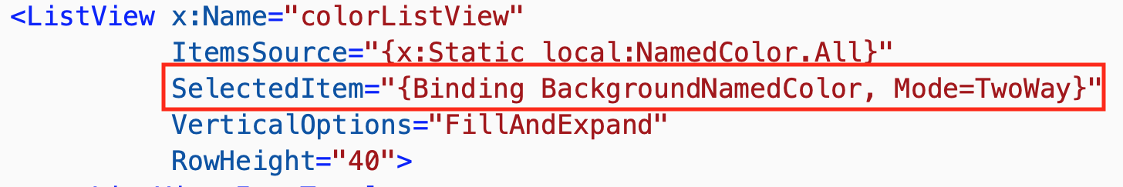

Slide 11
String Formatting

Slide 12
String Formatting
Sometimes it's convenient to use data bindings to display the string representation of an object or value. For example, you might want to use a Label to display the current value of a Slider. In this data binding, the Slider is the source, and the target is the Text property of the Label.

Slide 13
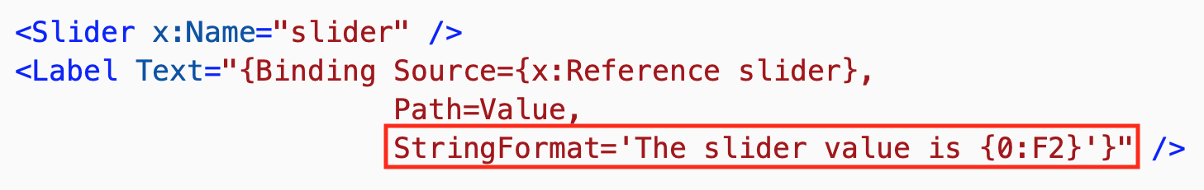

Slide 14
Binding Path

Slide 15
Binding Path
The Path property of the Binding class (or the Path property of the Binding markup extension) has been set to a single property. It's actually possible to set Path to a sub-property (a property of a property), or to a member of a collection.

Slide 16
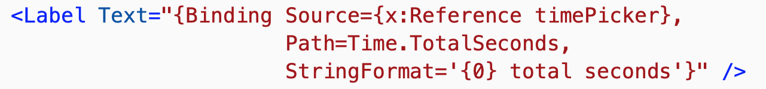


Slide 17
Binding Value Converters

Slide 18
Binding Value Converters
Data bindings usually transfer data from a source property to a target property, and in some cases from the target property to the source property. This transfer is straightforward when the source and target properties are of the same type, or when one type can be converted to the other type through an implicit conversion. When that is not the case, a type conversion must take place.

Slide 19
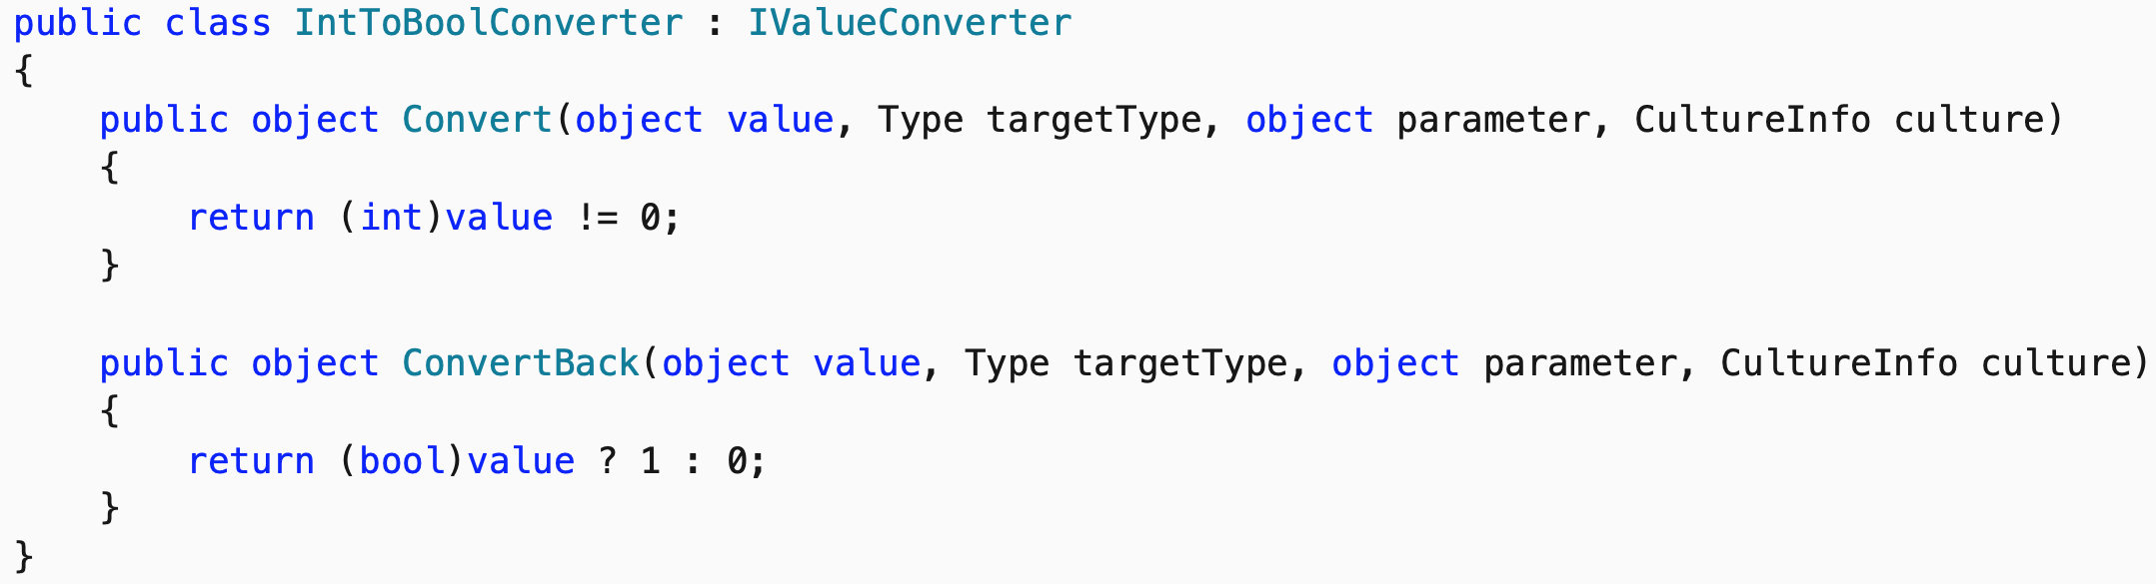
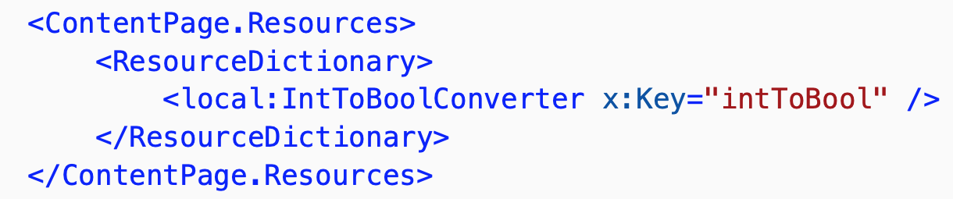
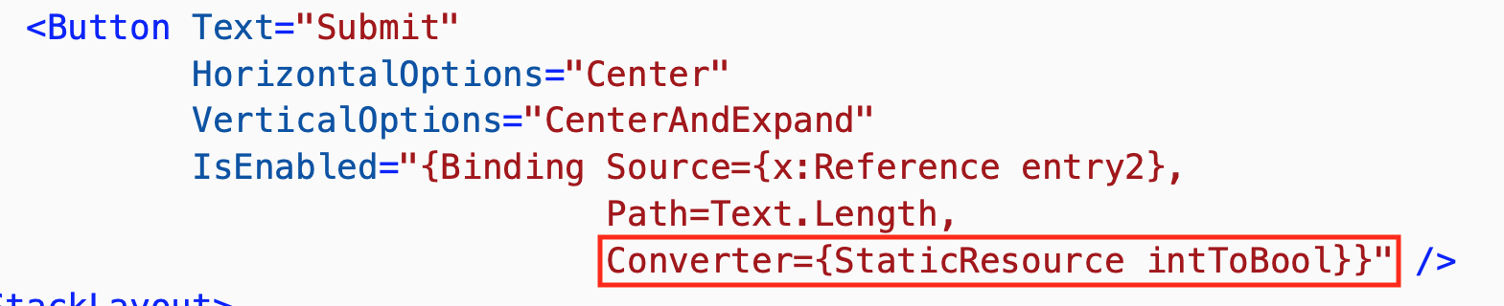

Slide 20
Relative Bindings

Slide 21
Relative Bindings
Relative bindings provide the ability to set the binding source relative to the position of the binding target. They are created with the RelativeSource markup extension, and set as the Source property of a binding expression.
The RelativeSource markup extension is supported by the RelativeSourceExtension class, which defines the following properties:
Mode
AncestorLevel
AncestorType

Slide 22
Relative Bindings
Modes:
TemplatedParent indicates the element to which the template, in which the bound element exists, is applied.
Self indicates the element on which the binding is being set, allowing you to bind one property of that element to another property on the same element.
FindAncestor indicates the ancestor in the visual tree of the bound element.
FindAncestorBindingContext indicates the BindingContext of the ancestor in the visual tree of the bound element.

Slide 23
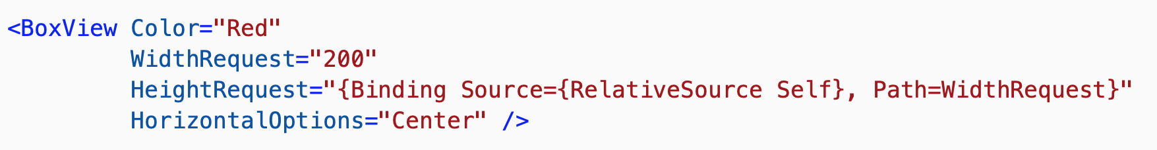



Slide 24
Binding Fallbacks

Slide 25
Binding Fallbacks
Sometimes data bindings fail, because the binding source can't be resolved, or because the binding succeeds but returns a nullvalue.
Two options are available:
FallbackValue: allows a fallback value to be defined that will be used when the binding source can't be resolved.
TargetNullValue: allows a replacement value to be defined that will be used when the binding source is resolved, but the value is null.

Slide 26



Slide 27
Compiled Bindings

Slide 28
Compiled Bindings
Compiled bindings improve data binding performance in Xamarin.Forms applications by resolving binding expressions at compile-time rather than runtime. In addition, this compile-time validation of binding expressions enables a better developer troubleshooting experience because invalid bindings are reported as build errors.
The process for using compiled bindings is to:
Enable XAML compilation. For more information about XAML compilation, see XAML Compilation.
Set an x:DataType attribute on a VisualElement to the type of the object that the VisualElement and its children will bind to.

Slide 29
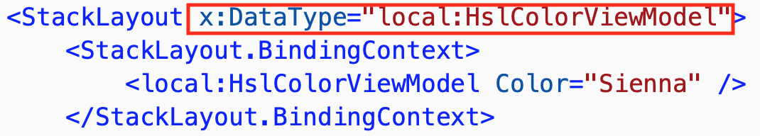

Slide 30
Demo Code

Slide 31
Resources: http://tiny.cc/XamarinFormsDataBinding

Slide 32



Slide 33
Thanks. Questions?
Alejandro Ruiz
Microsoft MVP
Data Binding for Xamarin Forms In-Depth
Demo Code: https://github.com/AlejandroRuiz/NetConfFocusXamarin
@alejandroruizva
alejandro@alejandroruizvarela.com

